Slide 1
Welcome to our presentation
On
Bioinformatics
Title: sequence Alignment
Md. Harun-Or-Roshid-(Kawsar)
Mst. Sharmin Akter
M.Sc. Students,2018
Dept. of Statistics, RU

Slide 2
Outline
Sequence alignment
Theoretical background
Terminology
Alignment method
Dot matrix method
Needleman-Wunsch algorithm
Smith-Waterman algorithm
Pairwise sequence alignment
Multiple sequence alignment
references

Slide 3
Sequence Alignment
In bioinformatics, a sequence alignment is a way of arranging the sequences of DNA, RNA, or protein to identify regions of similarity that may be a consequence of functional, structural, or evolutionary relationships between the sequences.
Alignments are useful organizing tools because they provide pictorial representation of similarity / homology in the protein or nucleic acid sequences.

Slide 4
Sample Alignment
SEQ_A: GDVEKGKKIFIMKCSQ
SEQ_B: GCVEKGKIFINWCSQ
There are two possible linear alignments
GDVEKGKKIFIMKCSQ
| |||||
GCVEKGKIFINWCSQ
2. GDVEKGKKIFIMKCSQ
|||| |||
GCVEKGKIFINWCSQ

Slide 5
The optimal alignment
GDVEKGKKIFIMKCSQ
| ||||| ||| |||
GCVEKGK-IFINWCSQ
Insertion of one break maximizes the identities.

Slide 6
Why Do Alignment?
homology: similarity due to descent from a common ancestor
often we can infer homology from similarity
thus we can sometimes infer structure /function from sequence similarity

Slide 7
Theoretical background
Alignment is the method based on the theoretical view that the two sequences are derived from each other by a number of elementary transformations –
Mutations (residue substitution)
Insertion/deletion
Slide function

Slide 8
Terminology
Identity
Similarity
Homology

Slide 9
What is Identity?
Objective and well defined
Can be quantified
Percent
The number of identical matches divided by the length of the aligned region

Slide 10
What is Similarity?
Objective and well defined
Can be quantified by using the ‘scoring schemes’
Percent
The number of “similar matches” divided by the length of the aligned region
Protein similarity could be due to –
Evolutionary relationship
Similar two or three dimensional structure
Common Function

Slide 11
What is Homology?
Homologous proteins may be encoded by-
Same genes in different species
Genes that have transferred between the species
Genes that have originated from duplication of ancestral genes.

Slide 12
Identity, Similarity and Homology
Example: There are two sequences
s1: A T T G C C T A and
s2: A G T G C T T G
Identity = 5/8*100 ≅ 62%
Similarity = 7/8*100 ≅ 87%
A
Homology
B
C
D
Orthologous
Paraologous

Slide 13
Difference between Homology and Similarity
Similarity does not necessarily imply Homology.
Homology has a precise definition: having a common evolutionary origin.
Since homology is a qualitative description of the relationship, the term “% homology” has no meaning.
Supporting data for a homologous relationship may include sequence or structural similarities, which can be described in quantitative terms.
% identities

Slide 14
An optimal alignment
AALIM
AAL-M
A sub-optimal alignment
AALIM
AA-LM

Slide 15
Issues in Sequence Alignment
The sequences we’re comparing probably differ in length
There may be only a relatively small region in the sequences that match
We want to allow partial matches (i.e. some amino acid pairs are more substitutable than others)
Variable length regions may have been inserted/deleted from the common ancestral sequence

Slide 16
Sequence Variations
Sequences may have diverged from a common ancestor through various types of mutations:
– substitutions (ACGA AGGA)
– insertions (ACGA ACCGGAGA)
– deletions (ACGGAGA AGA)
The latter two will result in gaps in alignments

Slide 17
Alignment methods
Computational approaches to sequence alignment generally fall into two categories:
Global alignments and
Local alignments.

Slide 18
Global alignments
Global alignments, which attempt to align every residue in every sequence, are most useful when the sequences in the query set are similar and of roughly equal size.
A general global alignment technique is the Needleman–Wunsch algorithm, which is based on dynamic programming.

Slide 19
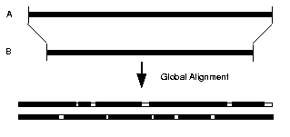
Global Alignment

Slide 20
Local alignments
Local alignments are more useful for dissimilar sequences that are suspected to contain regions of similarity or similar sequence motifs within their larger sequence context.
The Smith–Waterman algorithm is a general local alignment method also based on dynamic programming.

Slide 21
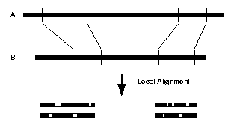
Local Alignment

Slide 22
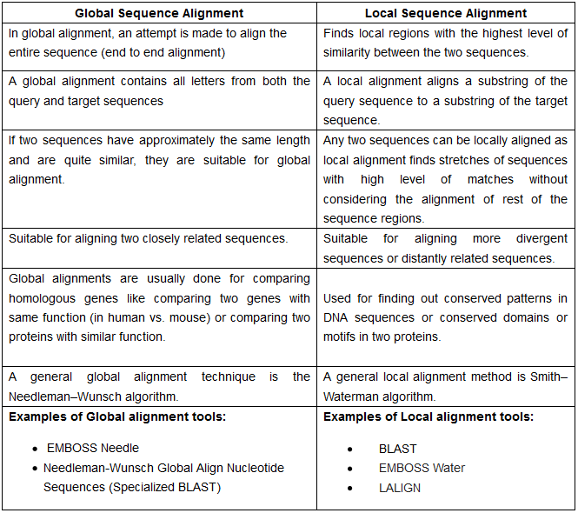
Difference between Global and Local sequence alignment
https://www.majordifferences.com/2016/05/difference-between-global-and-local.html#.WsGMWiBxXIU

Slide 23
Types of sequence alignment:
Generally sequence alignment are two types, such as,
Pairwise sequence alignment
Multiple sequence alignment (MSA)

Slide 24
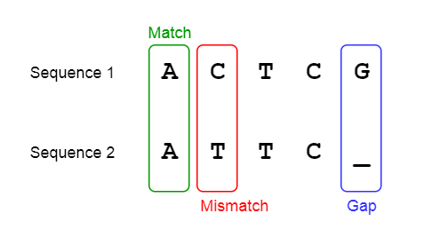
Pairwise sequence alignment
What is Pairwise Sequence Alignment?
Pairwise sequence alignment is one form of sequence alignment technique, where we compare only two sequences.
This process involves finding the optimal alignment between the two sequences, scoring based on their similarity (how similar they are) or distance (how different they are), and then assessing the significance of this score.
Example:

Slide 25
Pairwise sequence alignment
The three primary methods of producing pairwise alignments are:
Dot-matrix methods,
Dynamic programming, and
Word methods

Slide 26
Dot-matrix methods
A dot matrix analysis is a method for comparing two sequences to look for possible alignment (Gibbs and McIntyre 1970)
One sequence (A) is listed across the top of the matrix and the other (B) is listed down the left side
Starting from the first character in B, one moves across the page keeping in the first row and placing a dot in many column where the character in A is the same
The process is continued until all possible comparisons between A and B are made
Any region of similarity is revealed by a diagonal row of dots
Isolated dots not on diagonal represent random matches

Slide 27
Sequence comparison with dot matrices
Basic Method: For two sequences of lengths M and N, lay out an M by N grid (matrix) with one sequence across the top and one sequence down the left side. For each position in the grid, compare the sequence elements at the top (column) and to the left (row). If and only if they are the same, place a dot at that position.

Slide 28
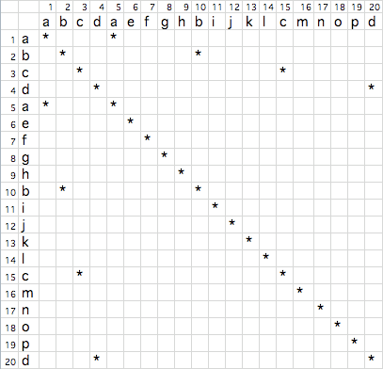
Sequence 1: abcdaefghbijklcmnopd vs. Sequence 2: abcdaefghbijklcmnopd

Slide 29
Interpretation of dot matrices
Regions of similarity appear as diagonal runs of dots
Reverse diagonals (perpendicular to diagonal) indicate inversions
Reverse diagonals crossing diagonals (Xs) indicate palindromes

Slide 30
Dynamic programming
The technique of dynamic programming can be applied to produce:
Global alignments via the Needleman-Wunsch algorithm,
Local alignments via the Smith-Waterman algorithm.

Slide 31
Needleman-Wunsch algorithm
The problem of finding best possible alignment of two sequences is solved by Needleman-Wunsch.
The algorithm was developed by Saul B. Needleman & Christain D. Wunsch in 1970.
It refers as optimal matching problem or global alignment.

Slide 32
Needleman-Wunsch algorithm
We will have two matrices: the score matrix and trace back matrix of 2d representation.
The Needleman-Wunsch algorithm consists of three steps:
Initialization of the score matrix
Calculation of score and filling the trace-back matrix
Deducing the alignment from the trace-back matrix.

Slide 33
Best possible alignment of two sequences
The N-W algorithm is mathematically proven to find the best alignment of 2 sequences
Which implies fewest number of mutation in two sequences
N-W algorithm takes n² to find best alignment of n letters 2 sequences
Accessing all possible alignment one by one takes ^{2n}C_{n} , so n² is much smaller
The N-W algorithm is faster than accessing all possible alignment one-by-one.

Slide 34
How to find the best score using substitution matrix?
A matrix D(i, j) indexed by residues of each sequence is built recursively, such that
D (i, j) = max D(i-1, j-1) + s(xi, yj)
D(i-1, j) + g
D(i, j-1) + g
Here: s(i, j) is the substitution score for residues i and j, and is the gap penalty.

Slide 35
Demo for sequence alignment using N-W Alg.
First we need to 2 sequence:
CTCGCAGC and CATTCAC
Second need score:
Match : +10
Mismatch: -2
Gap: -5
Lets create our matrix:
 | S | C | T | C | G | C | A | G | C
S | 0 | -5 | -10 | -15 | -20 | -25 | -30 | -35 | -40
C | -5 | 10 | 5 | 0 | -5 | -10 | -15 | -20 | -25
A | -10 | 5 | 8 | 3 | -2 | -7 | 0 | -5 | -10
T | -15 | 0 | 15 | 10 | 5 | 0 | -5 | -2 | -7
T | -20 | -5 | 10 | 13 | 8 | 3 | -2 | -7 | -4
C | -25 | -10 | 5 | 20 | 15 | 18 | 13 | 8 | 3
A | -30 | -15 | 0 | 15 | 18 | 13 | 28 | 23 | 18
C | -35 | -20 | 52 | 10 | 13 | 28 | 23 | 26 | 33

Slide 36
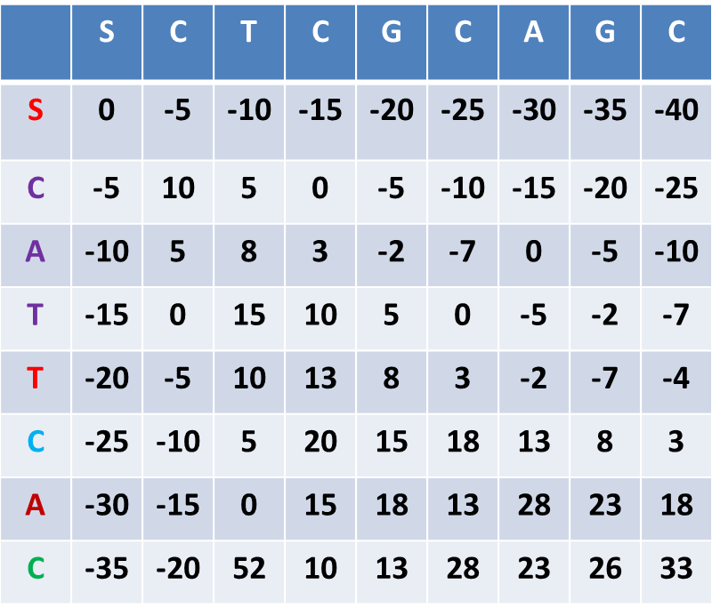
Trace-back step by step
Trace-back:
The final score: 33
Conclusion: The N-W algorithm is appropriate for finding the best alignment of two sequences.
C | - | T | C | G | C | A | G | C
C | A | T | T | - | C | A | - | C
+10 | -5 | +10 | -2 | -5 | +10 | +10 | -5 | +10

Slide 37
Smith-Waterman algorithm
Developed by Smith and Waterman.
It find the local regions with high level of similarity.
For draw the score matrix, the algorithm is same as N-W algorithm, but
When a value in the score matrix becomes negative, reset it zero.

Slide 38
Smith-Waterman algorithm
Local alignment for 2 sequence:
S-1: C T C G C A G C
S-2: C A T T C A C
When, +1 for a match, -1 for a mismatch and -5 for a space.
 | s | C | T | C | G | C | A | G | C
s | 0 | 0 | 0 | 0 | 0 | 0 | 0 | 0 | 0
C | 0 | 1 | 0 | 1 | 0 | 1 | 0 | 0 | 1
A | 0 | 0 | 0 | 0 | 0 | 0 | 2 | 0 | 0
T | 0 | 0 | 1 | 0 | 0 | 0 | 0 | 1 | 0
T | 0 | 0 | 1 | 0 | 0 | 0 | 0 | 0 | 0
C | 0 | 1 | 0 | 2 | 0 | 1 | 0 | 0 | 1
A | 0 | 0 | 0 | 0 | 1 | 0 | 2 | 0 | 0
C | 0 | 1 | 0 | 1 | 0 | 2 | 0 | 1 | 1

Slide 39
Smith-Waterman algorithm
Trace-back:
T | C | G | C
T | C | A | C
+1 | +1 | -1 | +1
Final score = 2

Slide 40
Word method
Word methods, also known as k-tuple methods, are heuristic methods that are not guaranteed to find an optimal alignment solution, but are significantly more efficient than dynamic programming.
Word methods are best known for their implementation in the database search tools FASTA and the BLAST family.
Word methods identify a series of short, non overlapping subsequences ("words") in the query sequence that are then matched to candidate database sequences.

Slide 41
Multiple Sequence Alignment (MSA)
Multiple sequence alignment is an extension of pairwise alignment to incorporate more than two sequences at a time.
Multiple alignment methods try to align all of the sequences in a given query set.
Alignment of 3 or (many) more sequences
RNA / DNA
Protein

Slide 42
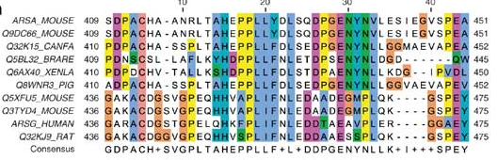
Anatomy of a MSA
GAPs
Protein Name
Sequence Position
Sequence Length
Consensus Sequence

Slide 43
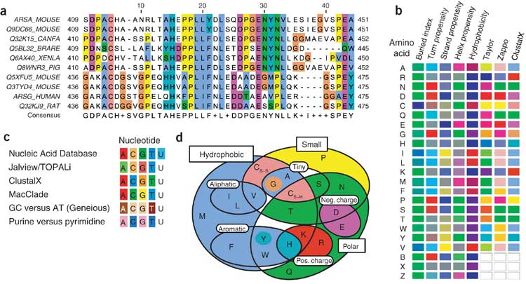
MSA

Slide 44
Pre-requisite knowledge
Knowledge of the following can help in your use of MSA:
Computational / Math / Statistics
Pairwise sequence alignment methods
Substitution matrices
Phylogenetic trees
Molecular Biology /Biochemistry
Genetics / sequencing /evolution
Structure – function
Bio-chemistry

Slide 45
Pre-requisite knowledge
Math / Statistics
Biology /Biochemistry
How specific in one field you want to go is up to you, but there are always others to collaborate with to complement your skillset.
Computer Science

Slide 46
What can you do with MSA?
Structural Prediction
Phylogeny
Prediction of Motifs
Functional Prediction

Slide 47
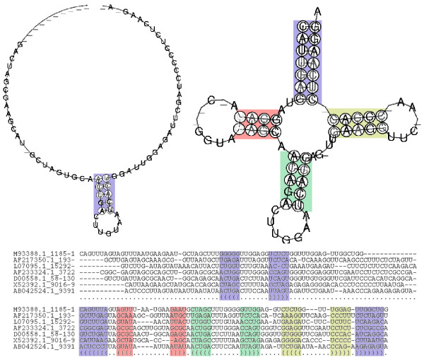
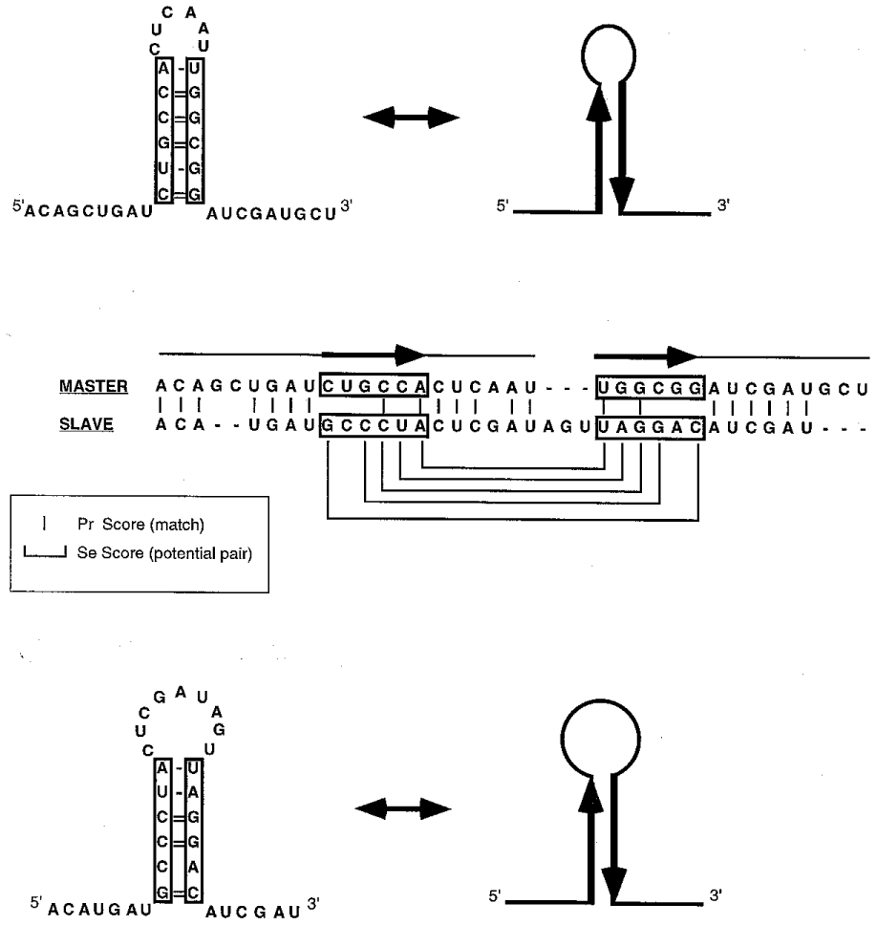
Application of MSA
RNA Structure Prediction
Bauer M, Klau GW, Reinert K. Accurate multiple sequence-structure alignment of RNA sequences using combinatorial optimization. BMC Bioinformatics. 2007 Jul 27;8:271
RAGA: RNA sequence alignment by genetic algorithm
Cédric Notredame^{1,}*, Emmet A. O'Brien^{1,2} and Desmond G. Higgins^{1,21}EMBL Outstation-The European Bioinformatics Institute, Welcome Trust Genome Campus, Hinxton, Cambridge CB10 1SD, UK and²Department of Biochemistry, University College, Cork, Ireland
Received July 23, 1997; Revised and Accepted October 1, 1997

Slide 48
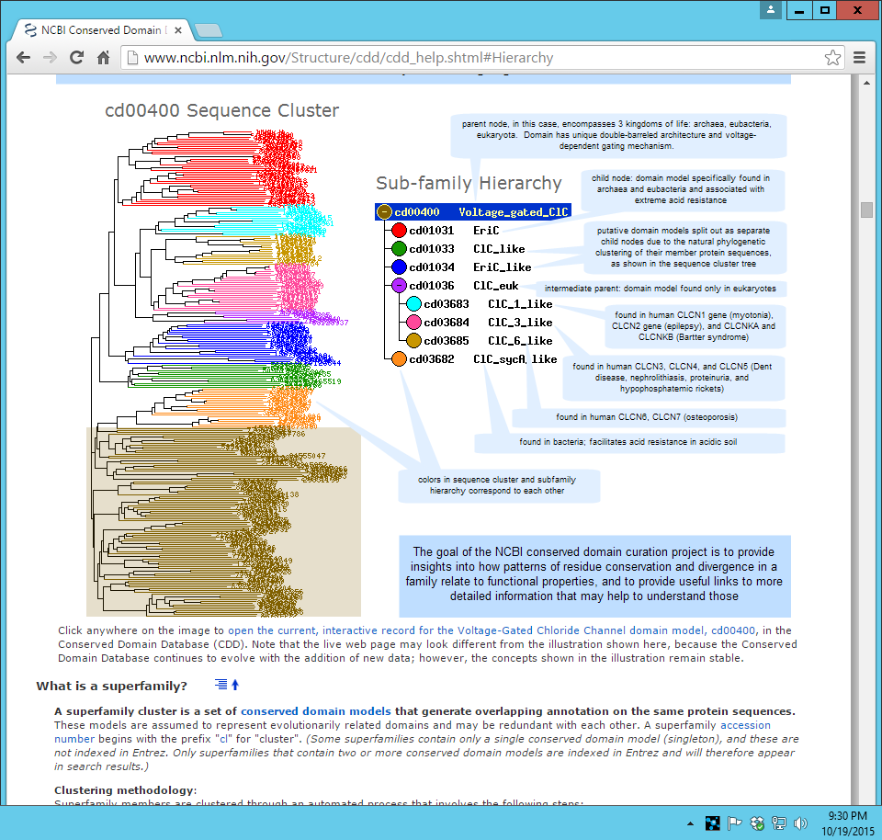
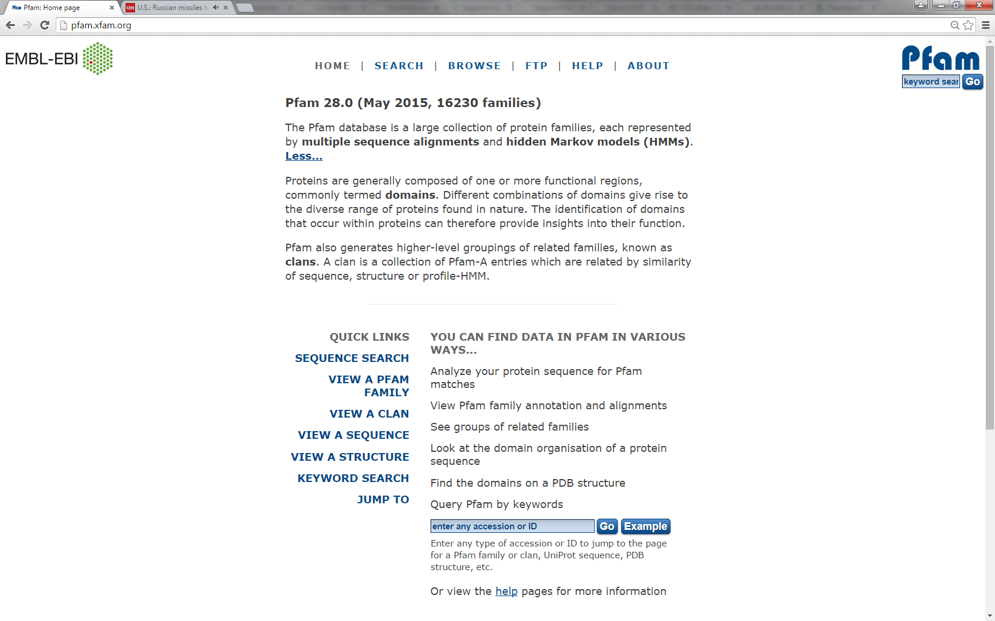
Application of MSA
Conserved domains / protein clusters
PFAM

Slide 49
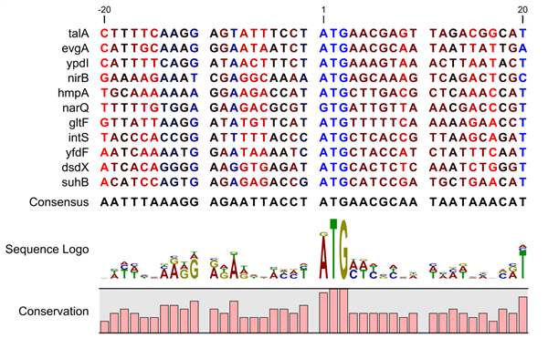
Application
Prediction / conserved motifs
http://www.clcsupport.com/clcgenomicsworkbench/650/BE_Sequence_logo.html

Slide 50
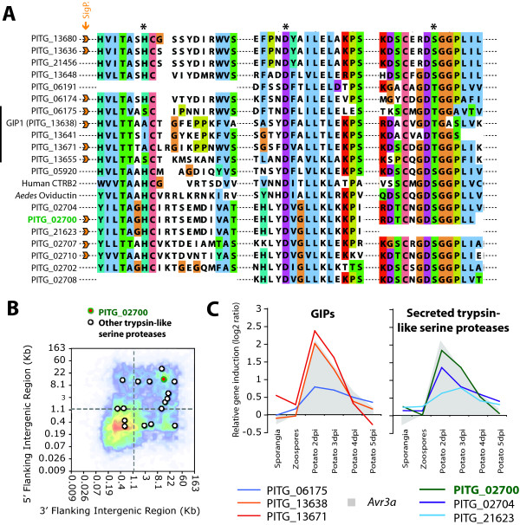
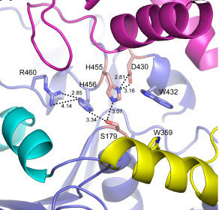
Application:
Biochemistry: structural / functional
http://openi.nlm.nih.gov/detailedresult.php?img=2893137_1741-7007-8-87-1&req=4

Slide 51
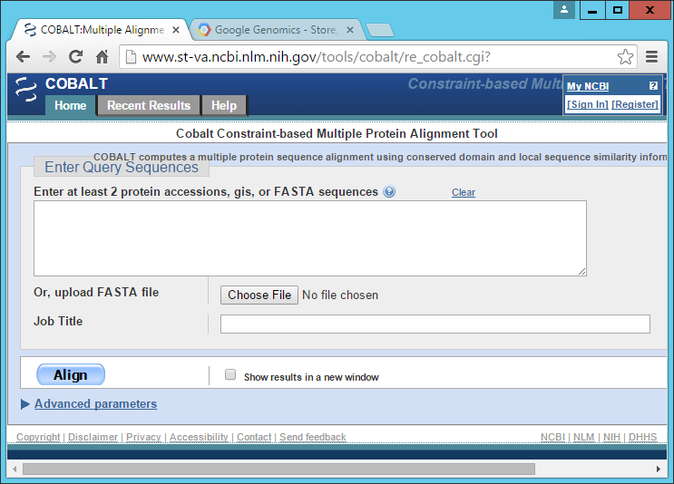
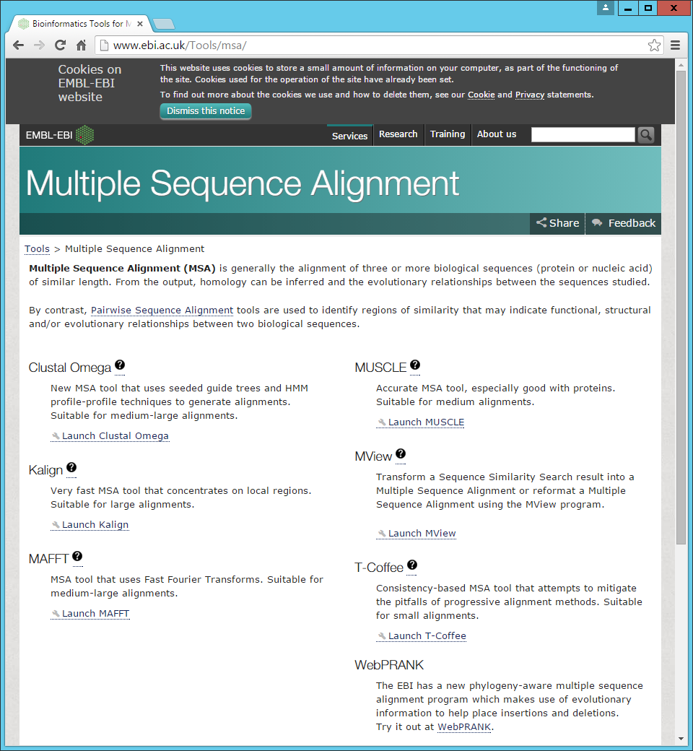

Available Tools

Slide 52
Computational method
Methods
Global versus Local….from pairwise analysis
Progressive / Iterative
Phylogeny Assistance
Others….

Slide 53
Conclusion
MSA requires pre-requisite knowledge to make informed choices about method choice
MSA requires pre-requisite knowledge to make informed choices about interpretation of the output
MSA is a core method for many bioinformatics studies
MSA has improved with information gain and technological advances

Slide 54
References
Google//bioinformatics//
Wikipedia//bioinformatics//
Youtube//bioinformatics//
www.cs.wisc.edu/~bsettles/ibs08/
http://www.wepapers.com/Papers/79336/dotplots.
http://www.vivo.colostate.edu/molkit/dnadot/
http://www.clcsupport.com/clcgenomicsworkbench/650/BE_Sequence_logo.html
http://openi.nlm.nih.gov/detailedresult.php?img=2893137_1741-7007-8-87-1&req=4

Slide 55


